Slide 1
Introduction to RTOS
Lecture 21, Embedded Systems, F18

Slide 2
Key characteristics of RTOS
reliability,
predictability,
performance,
compactness, and
scalability.

Slide 3
characteristics of RTOS: Reliability
a reliable system is one that is available (continues to provide service) and does not fail
Notes:
For example,
a digital solar-powered calculator might reset itself if it does not get enough light, yet the calculator might still be considered acceptable
a telecom switch cannot reset during operation without incurring high associated costs for down time

Slide 4
characteristics of RTOS: Predictability
Meeting time requirements is key to ensuring proper operation
The RTOS needs to be predictable to a certain degree to satisfy real time behavior
The predictable/deterministic behavior of RTOS will give some of consistent information about the response to different system calls
In good deterministic RTOS the variance of response time to different system call should be very small.
Notes:
Response time of a system

Slide 5
characteristics of RTOS: Performance
An embedded system must perform fast enough to fulfill its timing requirements. Typically, the more deadlines to be met—and the shorter the time between them—the faster the system’s CPU must be.
Software can also contribute to system performance.
the processor’s performance is expressed in million instructions per second (MIPS).
Throughput is the rate at which a system can generate output based on the inputs coming in. Data transfer throughput is typically measured in multiples of bits per second (bps).

Slide 6
characteristics of RTOS: Compactness
Application design constraints and cost constraints help determine how compact an embedded system can be.
Example:
a cell phone clearly must be small, portable, and low cost
So limit system memory, which limits the size of the application and operating system
In such embedded systems, where hardware real estate is limited due to size and costs, the RTOS clearly must be small and efficient.

Slide 7
characteristics of RTOS: Scalability
RTOS must be able to scale up or down to meet the application specific requirements
Depending on how much functionality is required, an RTOS should be capable of adding or deleting modular components, including file systems and protocol stacks.
Example:
Suppose that a development team wants to use an RTOS for the design of a cellular phone project and a base station project. If an RTOS scales well, the same RTOS can be used in both

Slide 8
Chapter – 5: Tasks

Slide 9
Introduction
Simple software → sequential
For Real Time Embedded systems we need concurrency

Slide 10
What is a Task?
A task is an independent thread of execution that can compete with other concurrent tasks for processor execution time
Notes:
Properties

Slide 11
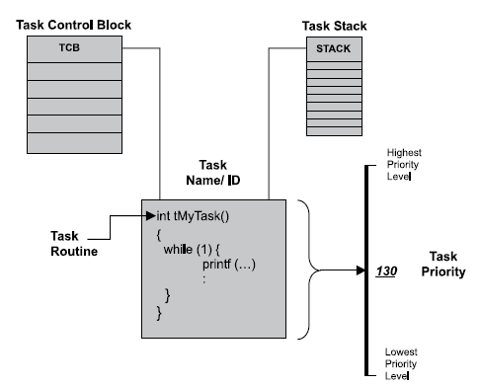

Slide 12
Types of Tasks
System tasks
Application Tasks

Slide 13
System Tasks
initialization or startup task
idle task
logging task
exception-handling task
debug agent task
System tasks have reserved priority levels
Notes:
• initialization or startup task—initializes the system and creates and starts system tasks,
• idle task—uses up processor idle cycles when no other activity is present,
• logging task—logs system messages,
• exception-handling task—handles exceptions, and
• debug agent task—allows debugging with a host debugger.
----
Kernel assigns priority to system task from its reserved priorities pool
App tasks should avoid using these priorities

Slide 14
The IDLE Task
Created at startup
Lowest priority
Endless loop
Use idle cycles of processor
Can be replaced by user configured functions
Notes:
IDLE task can be replaced by user defined routine. For example, user may replace it with some power saving routine

Slide 15
General setup
Kernel initialization
creates required tasks
Jumps to predefined entry point
Other tasks can be created and executed

Slide 16
Task States
At any time a task is in one of the following states
READY
RUNNING
BLOCKED

Slide 17
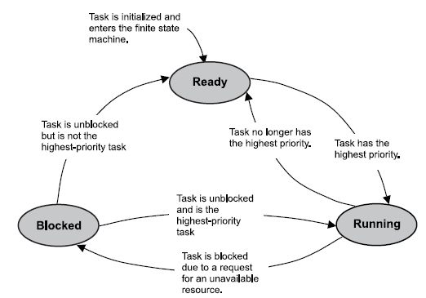

Slide 18
Ready State
When Task is created and made ready to run, it is in ready state
Task actively competes with all other ready tasks for the processor’s execution time
Transition to Blocked State :
Ready -> Running(Blocking Call)->Blocked

Slide 19
Ready State (contd.)
Ready Task can only move to Running state
It can not move from ready to blocked state
Many Tasks can be in Ready State
Scheduler chooses from list of ready task one task that will move to Running State

Slide 20
Ready State (contd.)
Task per priority level
One task per priority
Scheduling algorithm is simple
Multiple task can have same priority
Task ready list
Scheduling algorithm more complex

Slide 21
Running state
Only one task can run at a time
When the task is in running state, registers are loaded
Processor executes the instructions of the task
Notes:
How a task can move from running to ready

Slide 22
Running state (contd.)
a running task can move to the blocked state in any of the following ways:
by making a call that requests an unavailable resource
by making a call that requests to wait for an event to occur
by making a call to delay the task for some duration

Slide 23
Blocked State
If there was no blocked state, then low priority could not run
If higher priority tasks are not designed to block, CPU starvation can result
CPU Starvation:
CPU starvation occurs when higher priority tasks use all of the CPU execution time and lower priority tasks do not get to run.

Slide 24
Blocked State contd.
Until blocking condition is not met (It probably ought to be called the unblocking condition, but blocking is the terminology in common use among real-time programmers), task stays into blocking state
Examples of how blocking conditions are met include the following:
a semaphore token for which a task is waiting is released,
a message, on which the task is waiting, arrives in a message queue,
a time delay imposed on the task expires.

Slide 25
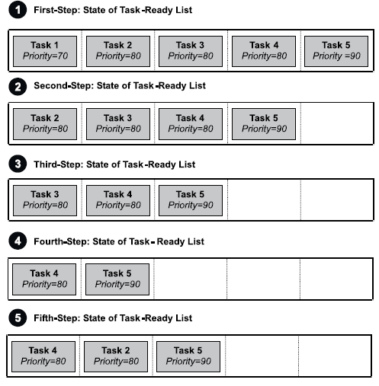
Example: how task-ready list works
This system assumes a single processor system
Preemptive scheduling algo is used in which 255 is lowest and 0 is highest
No system task is shown

Slide 26
Step – 1
TASK 1,2,3,4 and 5 are in ready state

Slide 27

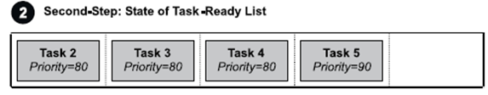
Step – 2
TASK1 has the highest priority , it is the first task to run
removed
running

Slide 28


Step – 3
During execution, task 1 makes a blocking call. As a result, the kernel moves task 1 to the blocked state; takes task 2, which is first in the list of the next-highest priority tasks (80), off the ready list; and moves task 2 to the running state.
blocked
removed
running

Slide 29


Step – 4
Next, task 2 makes a blocking call. The kernel moves task 2 to the blocked state; takes task 3, which is next in line of the priority 80 tasks, off the ready list; and moves task 3 to the running state.
blocked
removed
running

Slide 30
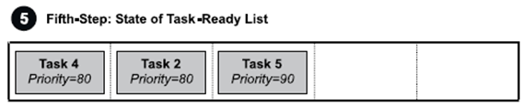
Step – 5
As task 3 runs, frees the resource that task 2 requested. The kernel returns task 2 to the ready state and inserts it at the end of the list of tasks ready to run at priority level 80. Task 3 continues as the currently running task.
running
TASK2 becomes ready

Slide 31

if task 1 became unblocked at this point in the scenario,
the kernel would move task 1 to the running state because its priority is higher than the currently running task (task 3). As with task 2 earlier, task 3 at this point would be moved to the ready state and inserted after task 2 (same priority of 80) and before task 5 (next priority of 90).
Currently running
Is TASK 3
Task – 1 is unblocked
TASK3 would move to ready state

Slide 32
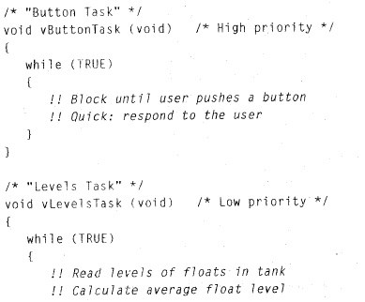
Example

Slide 33
